Slide 1

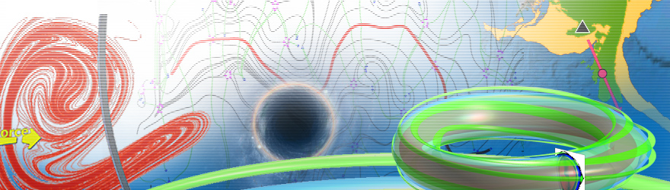
生物动力系统模拟
韦添元（助教）15811823840
11849117@mail.sustc.edu.cn
王冠宇 18665955633
wanggy@sustc.edu.cn

Slide 2
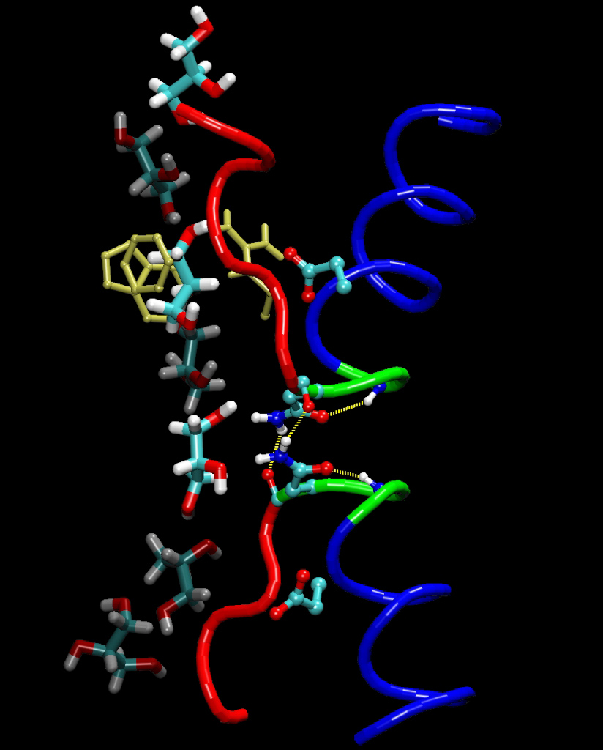
Molecular Dynamics Simulation (a brief introduction)

Slide 3
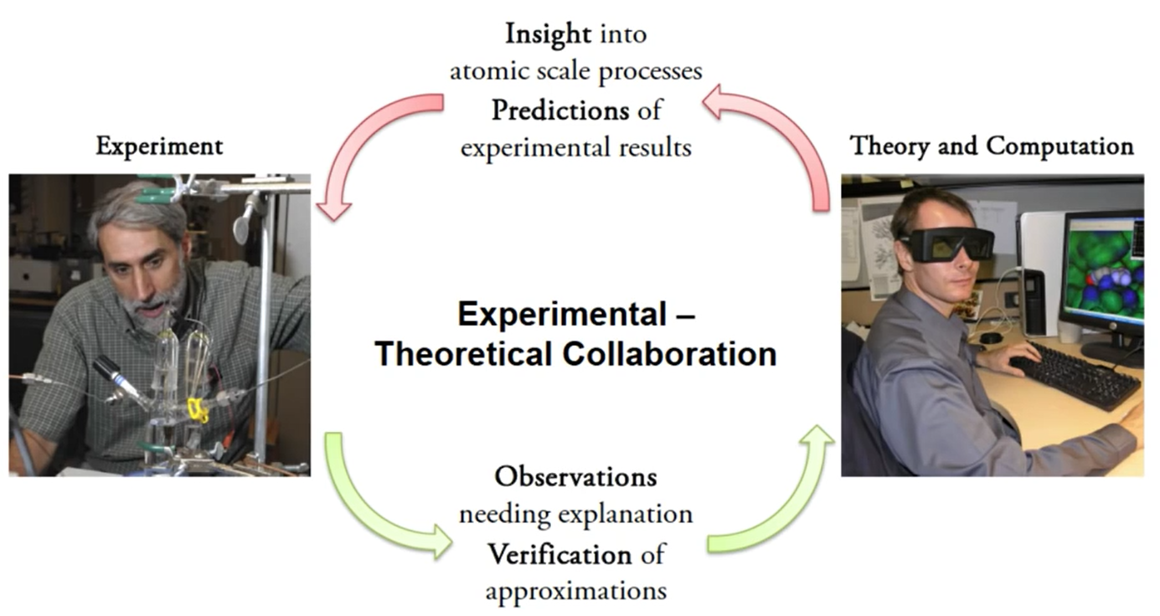

Slide 4
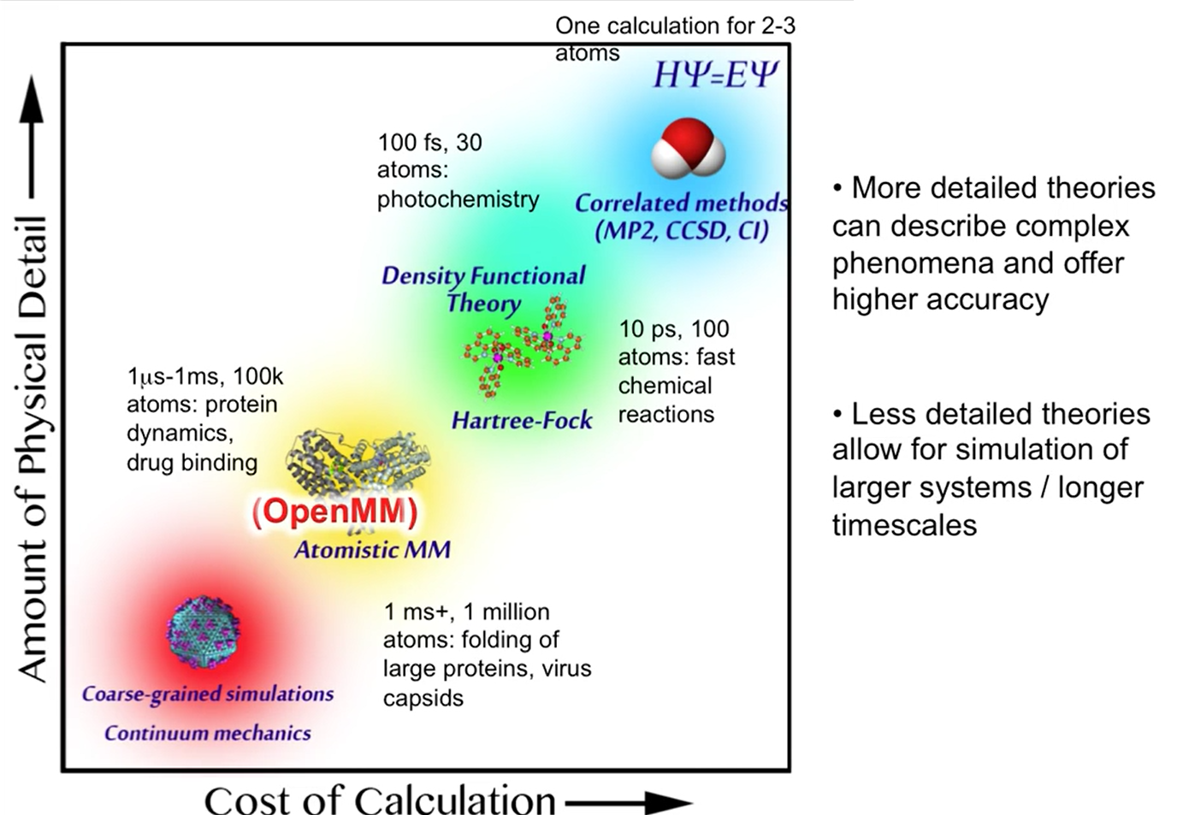

Slide 5
Why Not Quantum Mechanics?
Modeling the motion of a complex molecule by solving the wave functions of the various subatomic particles would be accurate…
But it would also be very hard to program and take more computing power than anyone has!

Slide 6
Classical Mechanics
Instead of using Quantum mechanics, we can use classical Newtonian mechanics to model our system.
This is a simplification of what is actually going on, and is therefore less accurate.
To alleviate this problem, we use numbers derived from QM for the constants in our classical equations.

Slide 7
Molecular Modeling
For each atom in every molecule, we need:
Position (r)
Momentum (m + v)
Charge (q)
Bond information (which atoms, bond angles, etc.)

Slide 8
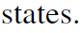
Interactions
Covalent Interactions
The macromolecules that participate in the structural and functional matrix of life are immense structures held together by strong, covalent bonds.
Noncovalent Interactions
Noncovalent interactions are critically important determinants of biomolecular structure, stability, and function.

Slide 9
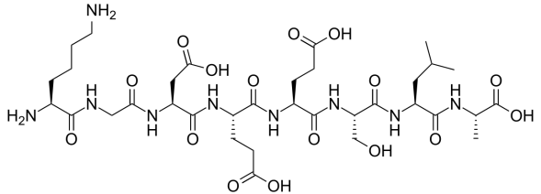
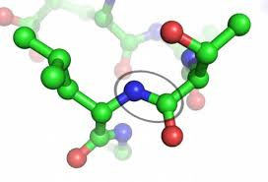
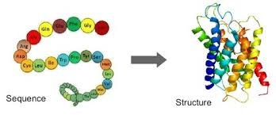
Consider proteins:
Proteins are polymers of amino acids.
The amino acids are held together by strong covalent amide (peptide) bonds.
The 3-D structure, and hence function of proteins are determined by a large number of noncovalent interactions.

Slide 10
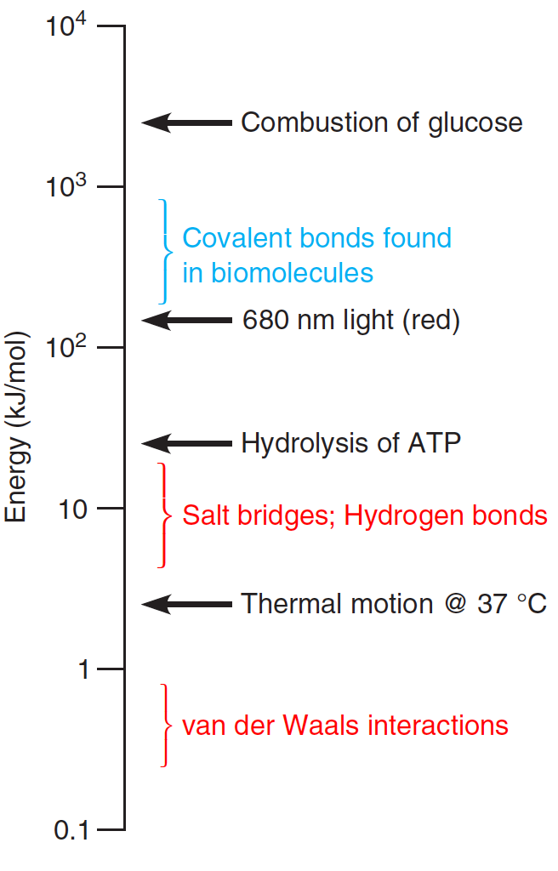
Covalent and noncovalent bond energies. Energies
typical of noncovalent bonds (0.5–20 kJ/mol; red text)
are about one to two orders of magnitude weaker than
energies of the covalent bonds commonly found in
biochemical compounds (150–600 kJ/mol; blue text).
The energies available from thermal motion, ATP
hydrolysis, red light, and aerobic glucose metabolism
are also shown as reference points

Slide 11
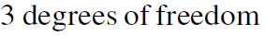
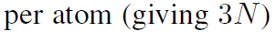
Covalent Interactions

Slide 12
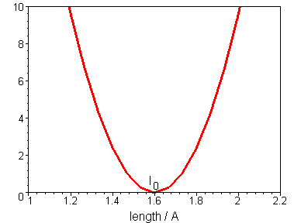
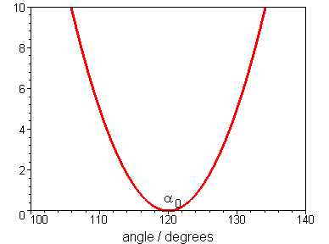
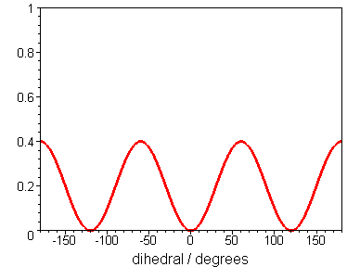
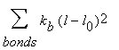
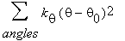
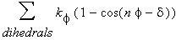
Covalent Interactions
Bond stretching
Angle bending
torsion
φ
θ
l

Slide 13
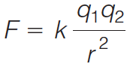
Noncovalent Interactions
All noncovalent interactions are electrostatic in nature.
The simplest electrostatic interactions are those between a pair of charged particles, called a salt bridge.
The attraction of the oppositely charged ions is governed by Coulomb’s Law:

Slide 14
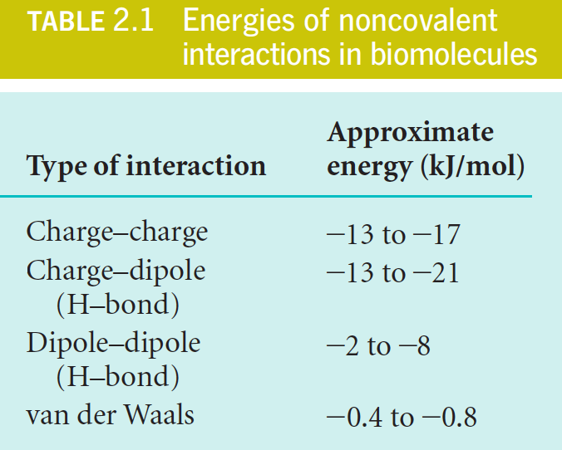

Slide 15
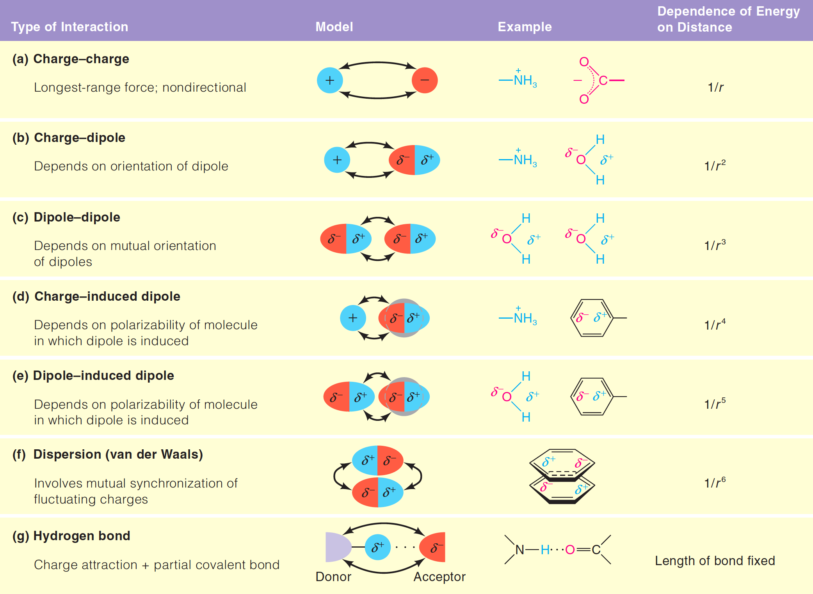

Slide 16
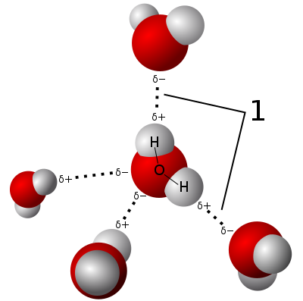
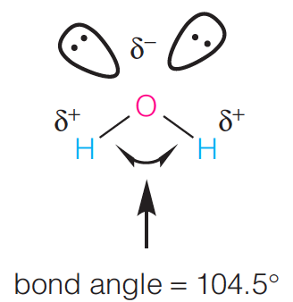
The Role of Water in Biological Processes
Hydrogen-bond donors and acceptors in water. The two nonbonded electron pairs on O act as H-bond acceptors and the two O-H bonds act as H-bond donors.
The angle between the two O-H bonds is 104.5; thus, water has a net dipole moment.

Slide 17
The Role of Water in Biological Processes
A skeletal model of the ice lattice.

Slide 18
The structure of liquid water.
When ice melts, the regular tetrahedral lattice is broken, but substantial portions of it remain, especially at low temperatures.
In liquid water, flickering clusters of molecules are held together by hydrogen bonds that continually
break and re-form.
In this schematic “motion picture,”
successive frames represent changes occurring in picoseconds (10⁻¹² s).

Slide 19
The Role of Water in Biological Processes
Water serves as the universal intracellular and extracellular medium, thanks primarily to two properties:
ability to form hydrogen bonds
polar character
Substances that can take advantage of these properties so as to readily dissolve in water are called hydrophilic, or “water loving.”

Slide 20
The Role of Water in Biological Processes
Water is an excellent solvent for ionic compounds.
The interactions of the negative ends of the water dipoles with cations and the positive ends with anions in aqueous solution cause the ions to become hydrated, that is, surrounded by shells of water molecules called hydration shells.
The dissolution of ionic compounds like NaCl in water can be
accounted for largely by two factors.
The formation of hydration shells is energetically favorable.
The high dielectric constant of water screens and decreases the electrostatic force between oppositely charged ions that would otherwise pull them back together.

Slide 21
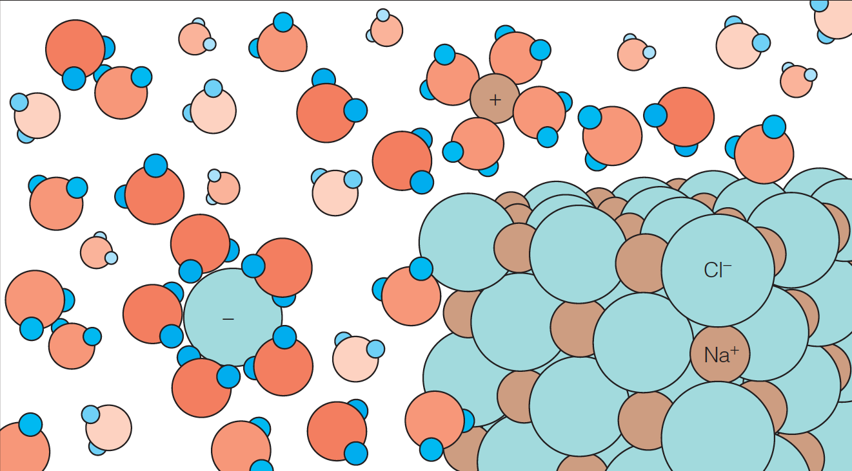
The Role of Water in Biological Processes
Hydration of ions in solution. A salt crystal is shown dissolving in water. As sodium and chloride ions leave the crystal, the noncovalent interaction between these ions and the dipolar water molecules produces a hydration shell around each ion. The energy released in this interaction helps overcome the charge–charge interactions stabilizing the crystal.

Slide 22
The Role of Water in Biological Processes
Nonpolar substances like hydrocarbons, are nonionic and cannot
form hydrogen bonds, show only limited solubility in water.
Such nonpolar molecules are called hydrophobic, or “water fearing.”
We can also call them lipophilic, or “fat loving.”
When hydrophobic molecules do dissolve, they are not surrounded by hydration shells, rather the regular water lattice forms ice-like clathrate structures, or “cages,” about the nonpolar molecules.

Slide 23
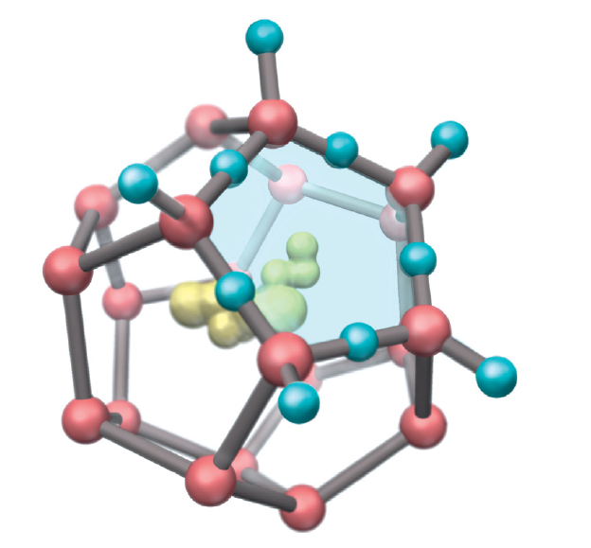
The Role of Water in Biological Processes
One unit of clathrate structure surrounding a hydrophobic molecule (yellow).
Oxygen atoms are shown in red. Hydrogens are shown for one pentagon of oxygens.
The ordered structure may extend considerably further into the surrounding water.

Slide 24
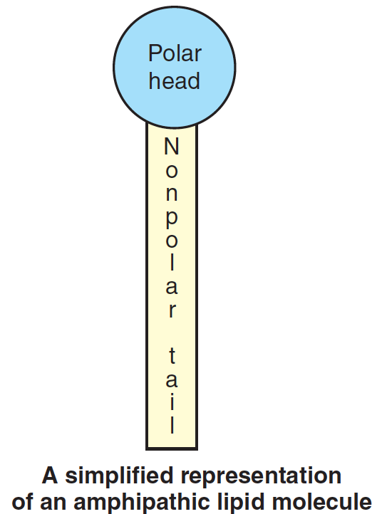
The Role of Water in Biological Processes
An important class of molecules are those that exhibit both hydrophilic and hydrophobic properties simultaneously.
Such amphipathic substances include
Fatty acids
Lipids
Detergents
The amphipathic molecules are characterized by a polar “head” group coupled to a hydrophobic “tail”—usually a hydrocarbon.

Slide 25
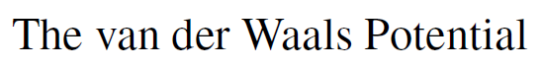
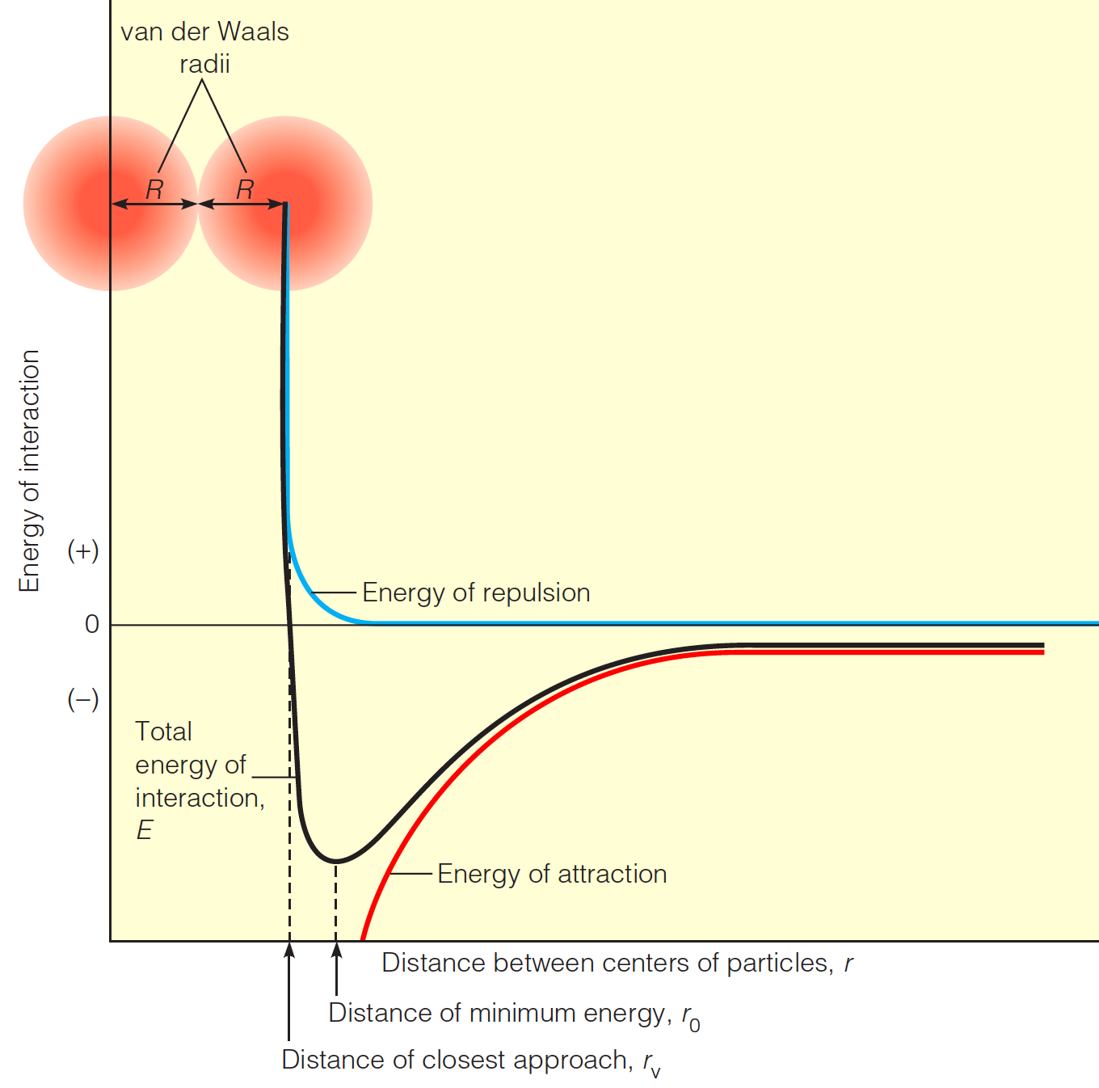

Slide 26
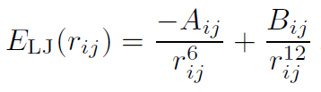
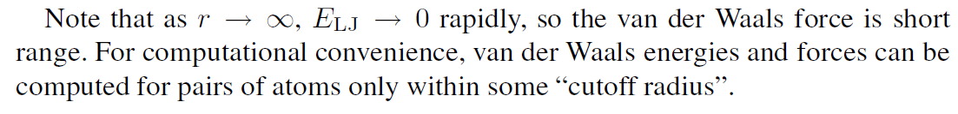
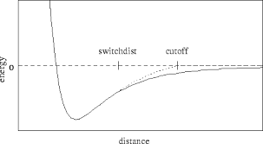
Where

Slide 27
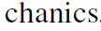
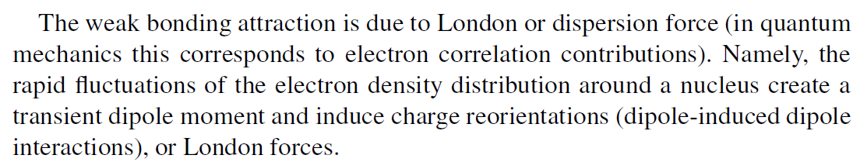

Slide 28
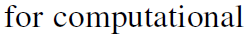
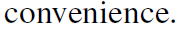
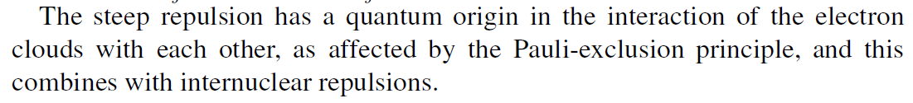


Slide 29
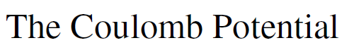
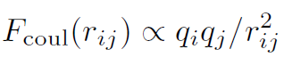
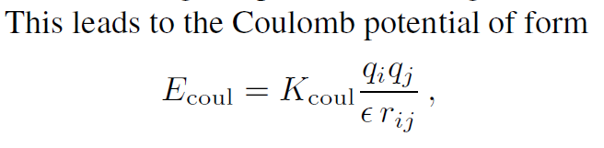

Slide 30
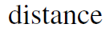
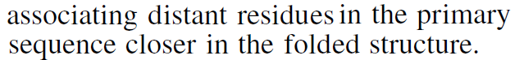
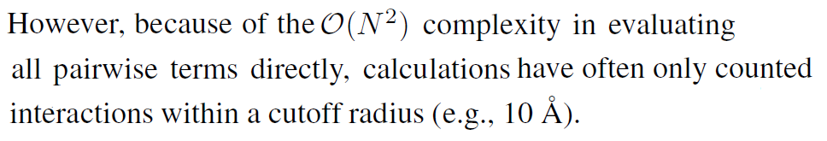
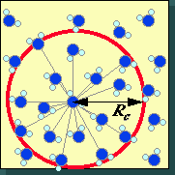

Slide 31
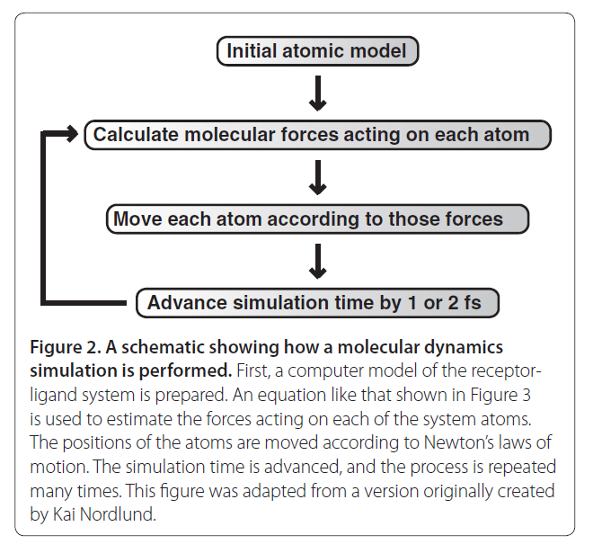
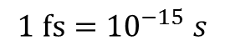
Steps
$$1 fs={10}^{−15} s$$

Slide 32
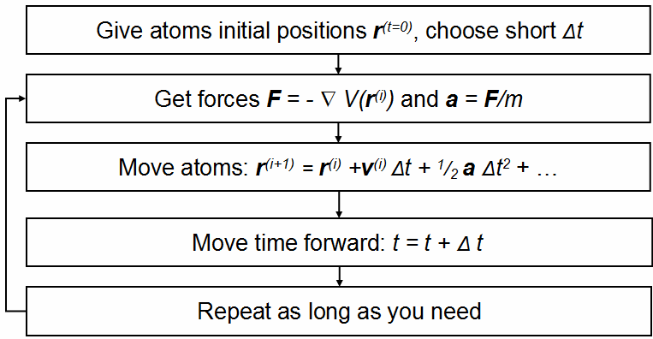
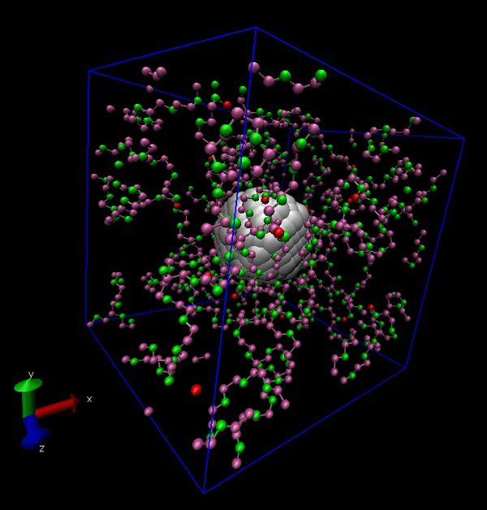

Slide 33
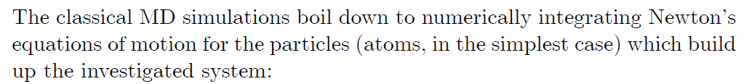
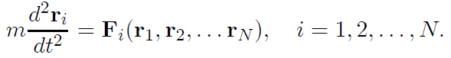
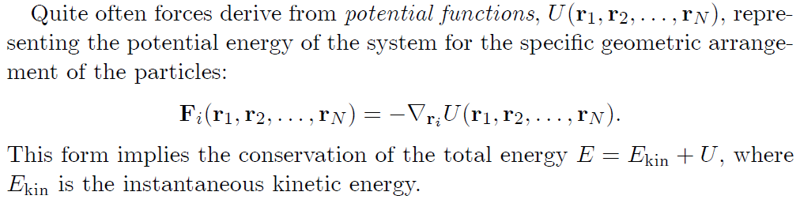

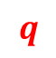
Basic Computation
$$r$$
In some context, we use instead of .
$$q$$

Slide 34


The fundamental reason is that the system is a Hamiltonian system
$$\frac{dp}{dt}=−\frac{∂V}{∂q}$$

Slide 35






$$\frac{dp}{dt}=−\frac{∂V}{∂q}$$
$$p=mv=m\frac{dq}{dt}$$
$$m\frac{d^{2}q}{dt^{2}}=−\frac{∂V}{∂q}$$
$$F=−\frac{∂V}{∂q}$$
$$F_{i}=−\frac{∂V}{∂q_{i}}$$

Slide 36


$$θ=\cos^{−1} \frac{\left(r_{k}−r_{j}\right)∙\left(r_{i}−r_{j}\right)}{\left|r_{k}−r_{j}\right|\left|r_{i}−r_{j}\right|}$$

